Slide 1

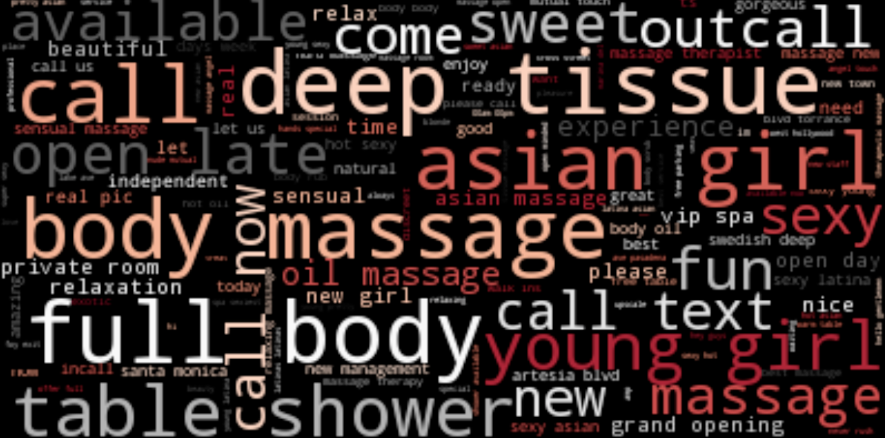
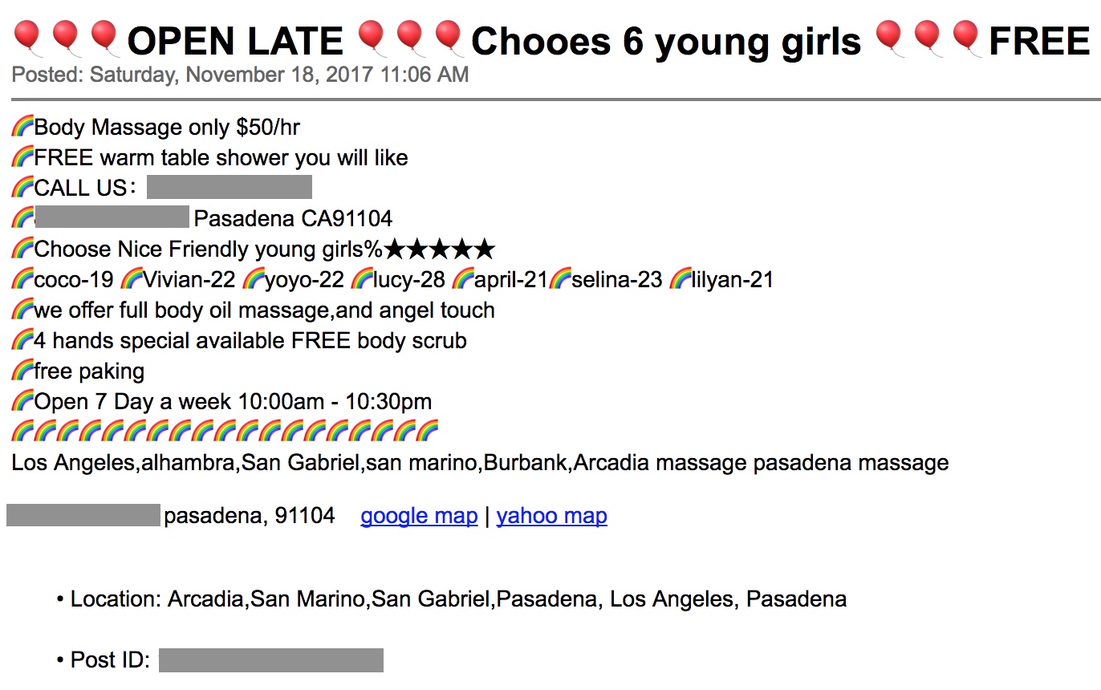
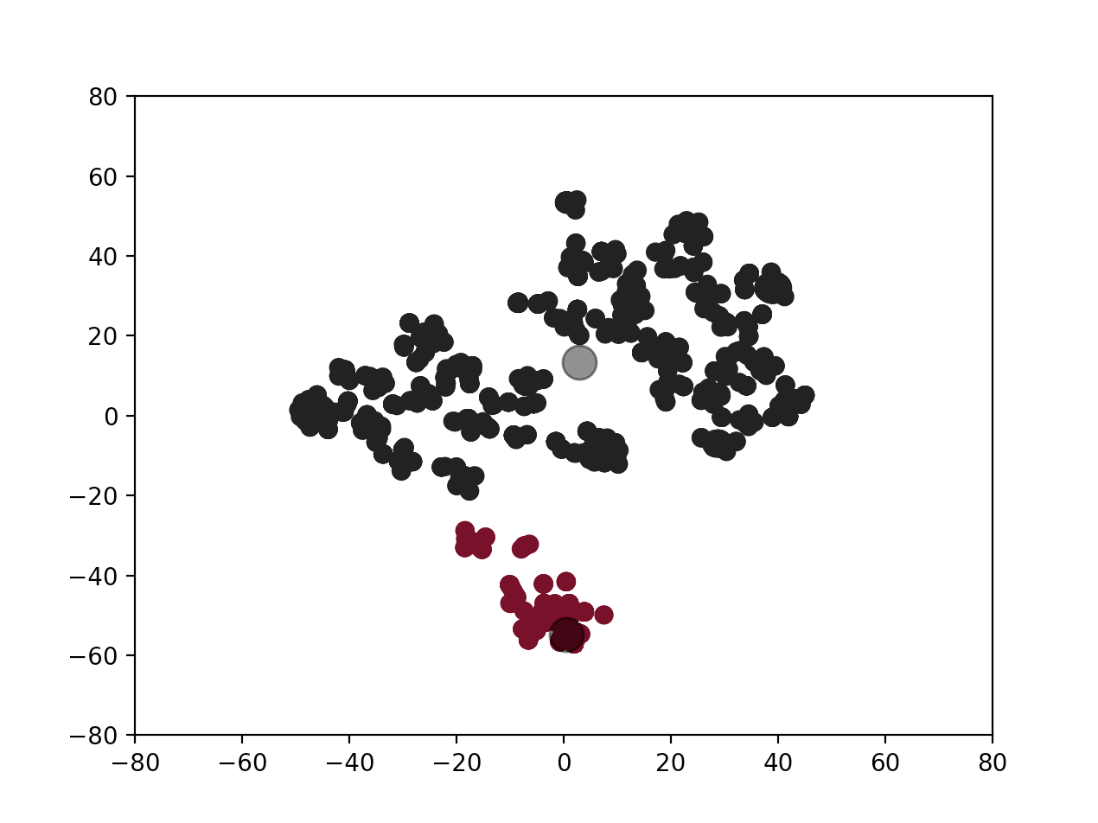
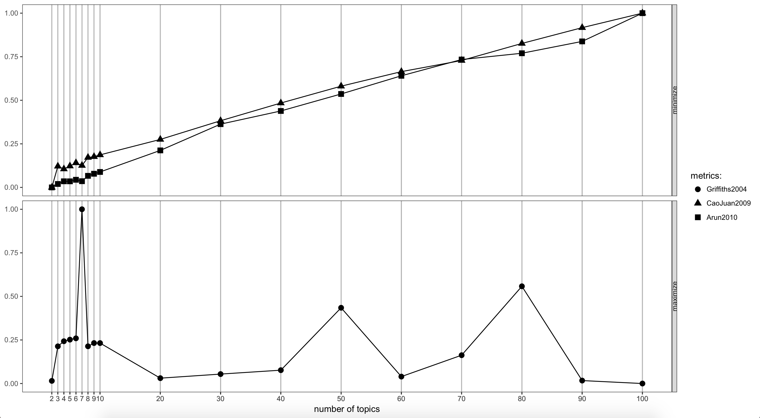
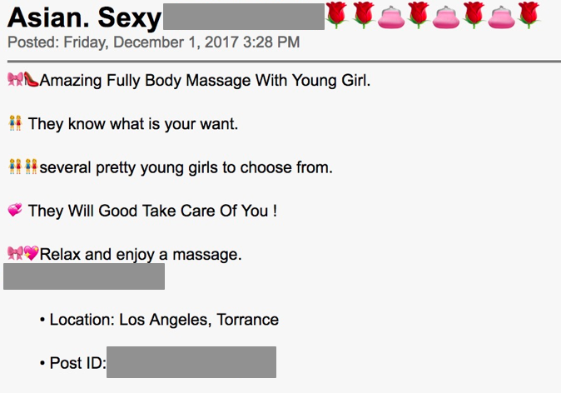
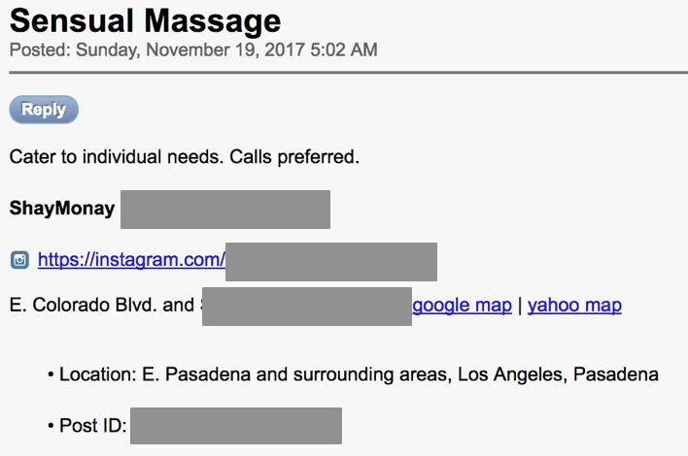
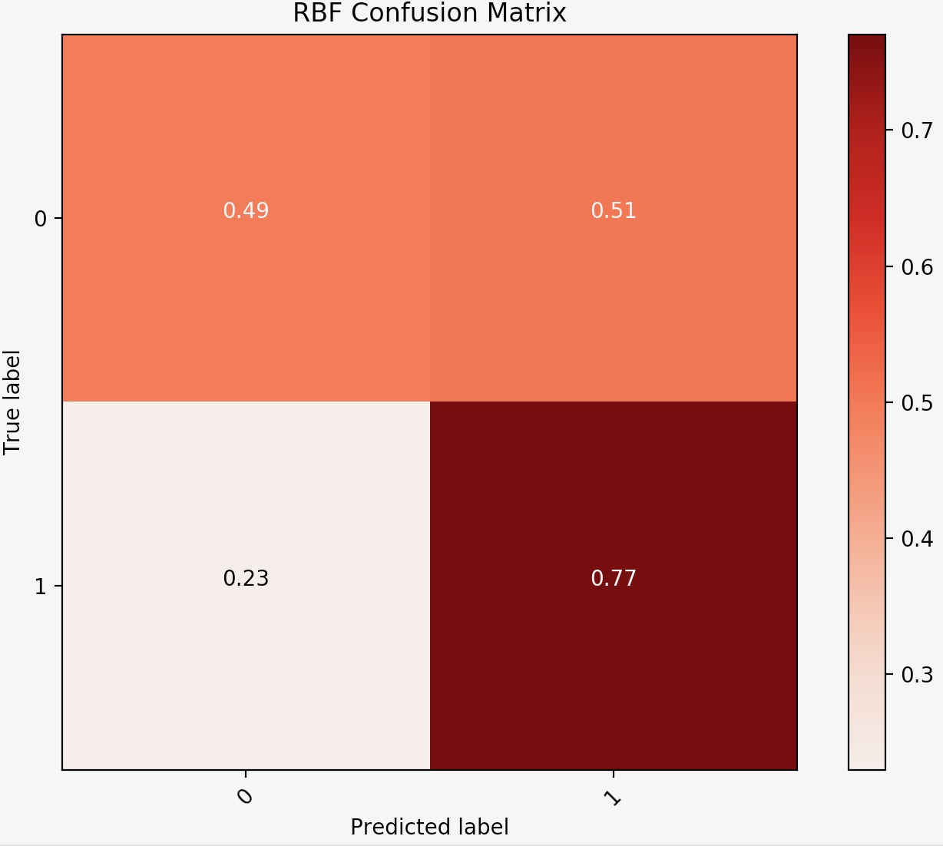
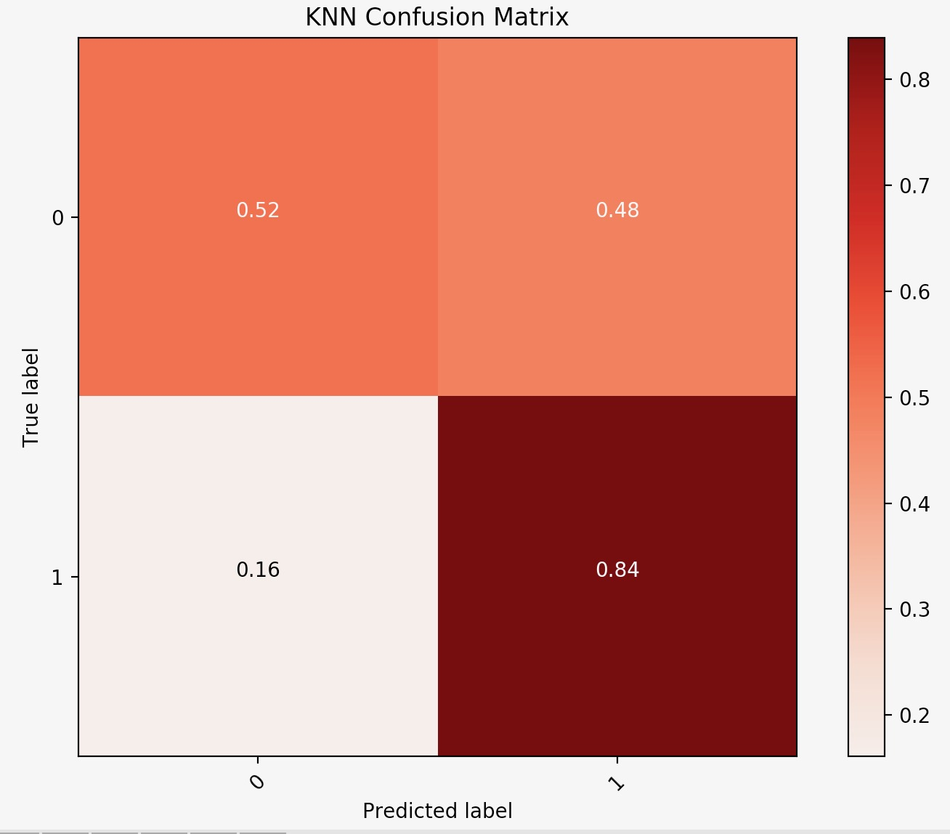
A Semi-Supervised Deep Learning Framework for the Automated Detection of Online Human Trafficking
Swetha Revanur and Keanu Spies
(srevanur, keanus) @ stanford.edu
Abstract #
20980123
CS221: Artificial Intelligence: Principles and Techniques
Human Trafficking
Phase I: Feature Engineering and Unsupervised Filtering
Phase II cont’d.
Classified advertising has facilitated the vast majority of human trafficking in the United States. The National Center for Missing and Exploited Children found that a whopping 73% of child trafficking reports occur via Backpage.com.
A. Feature Engineering
Represent each post as a 19-dimensional binary feature vector:
B. Unsupervised Filtering
We obtain 1857 records from our dataset by filtering out samples that don’t possess any of the binary features. This is our filtered dataset.
E. Deep Ladder Networks cont’d.
Feature Group | Features
Language Pattern | third-person voice, first-person plural pronouns, Shannon entropy to assess text complexity, n-grams with TF-IDF (n = 3)
Keywords | [young, fresh, new, new in town, new arrival, open minded, petite, exotic, youthful, barely legal, virgin, tiny, incall, in call, new to the game, candy == 1]
Countries of Interest | [china, vietnam, korea, thailand, asian == 1]
Multiple Victims | [girls, women, men, boys, people, children, babes, dolls, masseuses == 1]
Victim Weight | [victim weight ≤110]
Spa Reference | [spa, massage == 1]
Presence of Emojis | [🌹, 🍒, 🌸, 💗, ✈️, 👑 == 1]
To verify the fidelity of our filtering we apply the t-SNE transformation to create 2D projections of the filtered and junk feature vectors. We cluster these projections using K-means (K = 2).
This is due to a lack of robust models to identify trafficking-related classified ads.
filtered
junk
Objectives
Design and develop an unsupervised filtering technique to identify posts likely to be related to human trafficking.
Employ semi-supervised learning to build a more robust classifier.
Phase II: Semi-Supervised Classification
Results
A. Expert Labeling
Since we lack ground truth for our data, we rely on manual labels provided by experts.
Of the 1857 records, 300 were labeled.
Semi-Supervised Classification Task Definition
We have now reduced our task to a semi-supervised binary classification problem (semi-supervised due to the presence of both labeled and unlabeled data).
We report the preliminary accuracies of the the various approaches when trained on a subset of the filtered dataset:
We observe that our TensorFlow implementation of Deep Ladder Networks achieves the highest accuracy. On the left, is a Backpage post correctly classified as human trafficking. On the right is a post correctly classified as a consensual activity.
Approach | Precision | Recall | Accuracy
Baseline Majority Algorithm | --- | --- | 56.667%
Oracle | 100% | 100% | 100%
Label Spreading (RBF) | 64% | 64% | 63%
Label Spreading (KNN) | 70% | 68% | 67%
Deep Ladder Networks | --- | --- | 80%
Preprocessing
B. Baseline and Oracle
The baseline is a majority algorithm for post classification. The majority algorithm classifies all the examples in the testing set as the majority class of the training set.
The oracle is manual labeling of the entire filtered dataset.
C. Feature Extraction with Topic Modeling
Using Latent Dirichlet Allocation (LDA) topic modeling, we extract 7 of the most representative topics in the filtered dataset. LDA hyperparameters were tuned by evaluating the metrics proposed by Griffiths, Cao/Juan, and Arun.
A web crawler was built and deployed to recursively collect URLs for 2738 posts spanning 7 categories (Dating, MenSeekMen, MenSeekWomen, WomenSeekWomen, WomenSeekMen, Transgender, and Massage). Using batch processing, the corresponding post's ID, original text, title, date, location, phone number, and category were parsed from the HTML.
Posts are informal and unstructured. To normalize and extract relevant textual data, preprocessing was conducted:
Strip HTML tags
Casefolding
Expand contractions
Strip phone numbers
Strip punctuations
Removal of one-character-long words
Emoji tokenization
Stop word removal
We generate a secondary 7-dimensional feature vector for each post from the document-topic distributions.
D. Label Spreading
Label spreading is a semi-supervised graph inference algorithm. Each unlabeled node inherits a label diffused from its similar labeled neighbors. The RBF kernel will produce a fully connected graph which is represented as a dense matrix. The KNN kernel will produce a sparse matrix which can reduce running times.
E. Deep Ladder Networks
Ladder networks apply deep neural networks to simultaneously minimize the sum of supervised and unsupervised cost functions by backpropagation during training.
Selected References
Alvari et al., A Non-Parametric Learning Approach to Identify Online Human Trafficking
Rasmus et al., Semi-Supervised Learning with Ladder Networks

